Slide 1
CMSC 471
ML : Tools
(in Python)

Slide 2
Motivation
Machine learning involves working with data
analyzing, manipulating, transforming, …
More often than not, it’s numeric or has a natural numeric representation
Natural language text is an exception, but this too can have a numeric representation
A common data model is as a N-dimensional matrix or tensor
These are supported in Python via libraries

Slide 3
Motivation
Python is a great language, but slow compared to Java, C, and many others
Python packages are available to represent, manipulate and visualize matrices
We’ll briefly review numpy and scipy
Needed to create or access datasets for ML training, evaluation and results
And touch on pandas (data analysis and manipulation) and matplotlib (visualization)

Slide 4
Numpy
Numpy stands for numerical python.
Open-Source library
Useful for crunching numbers.
Why Numpy?
NumPy supports features needed for ML
Typed N-dimensional arrays (matrices/tensors)
Fast numerical computations (matrix math)
High-level math functions
Python does numerical computations slowly and lacks an efficient matrix representation
1000 x 1000 matrix multiply
Python triple loop takes > 10 minutes!
Numpy takes ~0.03 seconds
To install Numpy:
pip install numpy
Resources:
https://www.w3schools.com/python/numpy/default.asp

Slide 5
NumPy Arrays, Basic Properties
>>> import numpy as np
>>> a= np.array([[1,2,3],[4,5,6]],dtype=np.float32)
>>> print(a.ndim, a.shape, a.dtype)
(2, 3) float32
>> print(a)
[[1. 2. 3.] [4. 5. 6.]]
Arrays:
Can have any number of dimensions, including zero (a scalar)
Are typed: np.uint8, np.int64, np.float32, np.float64
Are dense: each element of array exists and has the same type

Slide 6
NumPy Array Indexing, Slicing
a[0,0] # top-left element
a[0,-1] # first row, last column
a[0,:] # first row, all columns
a[:,0] # first column, all rows
a[0:2,0:2] # 1st 2 rows, 1st 2 columns
Notes:
Zero-indexing
Multi-dimensional indices are comma-separated)
Python notation for slicing

Slide 7
Pandas
Python opensource library for data analysis
Pandas is structured around DataFrame objects.
DataFrame can be used to load your data and pandas function can help you manipulate the data.
Some of the things that Pandas support:
Reading and writing data from different formats such as .csv, .txt, .xlsx, SQL, etc.
Merging and joining of data sets
Data alignment and handling of missing data, data type etc.
To install Pandas:
pip install pandas
To import Pandas:
import pandas as pd
Pandas complete documentation:
https://pandas.pydata.org/

Slide 8
SciKit Learn
Scikit-Learn (sklearn) is an open-source library for Machine Learning in Python.
Complete Documentation:
https://scikit-learn.org/stable/
User Guide has list of most ML models that you will be needing to get started

Slide 9
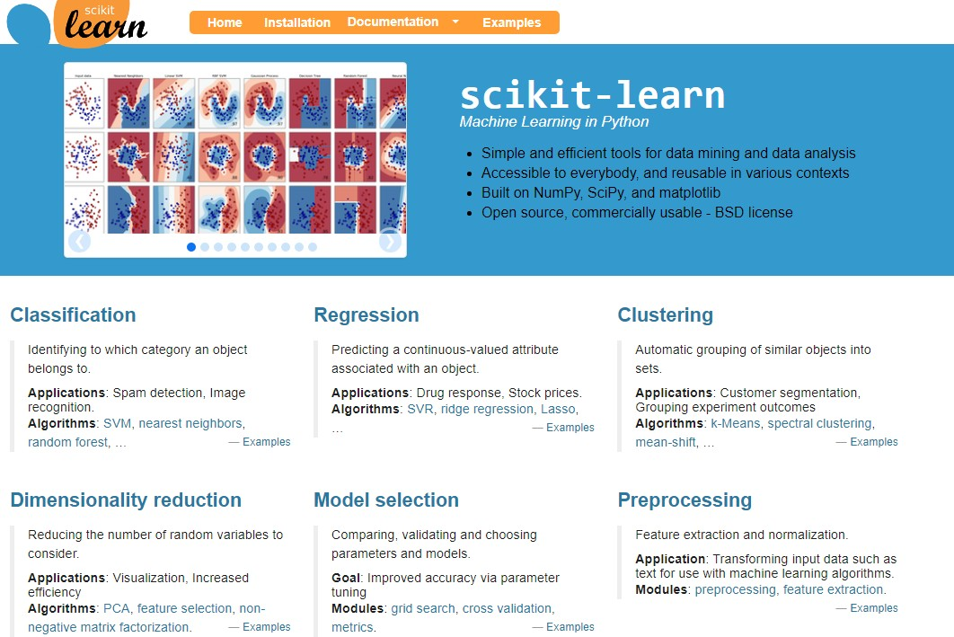
https://sklearn.org/
Documentation online
Many tutorials
75

Slide 10
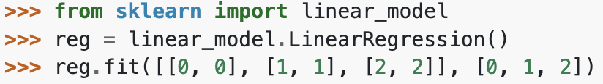
Scikit Learn
Example of linear model
Import model
Create instance
Fit data and train

Slide 11
Preprocessing data
Clean the data:
Pick relevant features
Change data type
Fill in Null Values; Clean garbage values etc.
Convert Categorical Variables into Numerical Variables
sklearn.preprocessing:
Includes function for binarizing data, label encoding, one hot encoding…
Using pandas:
pd.Categorical(pd.factorize(…)[0])

Slide 12
Test-Train Split
You can use Numpy or Pandas to randomly select datapoints to create your training and test data
Remember test and training data must be disjoint
Sklearn also has helpful functions to split your dataset: Model Selection
Train_test_split

Slide 13
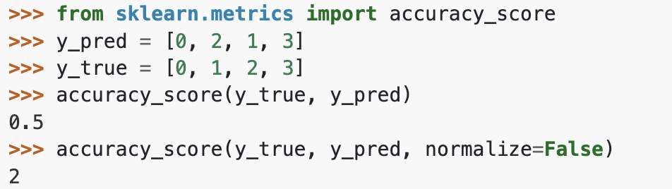
Evaluation
Common evaluation metrics can be found in sklearn.metrics

Slide 14
Implementing ML in Python
Numpy, Pandas and Scikit Learn work together.
Default implementation:
Load/clean/manipulate your data using Pandas
Translate your Pandas DataFrame into a Numpy array
Feed it to Scikit Learn function(s)

Slide 15
Example Implementation
Iris Data Classification with Random Forest Classifier : here

